Slide 1
2010 Ames Property Market Sharing - By 5AM Club
PROJECT 2 - Ames Housing and Kaggle Challenge
By 5AM Club
Andrew Chia
Deepankar Sharma
Tan Wee Jin
Tay Yi Li

Slide 2
Background
5AM Club is a Data Science Agency that specialises in creating customised business solutions for its clients.
Some of our clients include the United States Federal Government, the United States Men’s National Soccer Team and even real estate tycoon Donald Trump (we were not fired!)
Today, based on data from houses sold in Ames in 2006-2010, we are going to share some important insights from our study to help you, the realtors of Skywalker Property Advisors, reach greater heights!

Slide 3
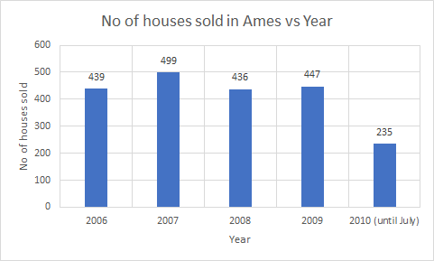
Background
Situation of the property market in Ames:
Sales have been relatively stable across the last 4 years, despite experiencing a subprime Financial Crisis since 2008.

Slide 4
Content
Problem Statement
Methodology
Findings and Recommendations
Conclusion and Future Work

Slide 5
Problem Statement
“This project aims to identify areas contributing to high transacted prices and where the highest transacted volume occurs, using a data science approach, so as to help realtors of Skywalker Property Advisors gain a competitive advantage in the Ames Housing Market.”

Slide 6
Methodology
Dataset we have used for analysis:
2051 transaction entries describing the sale of individual residential property in Ames, Iowa from 2006 to July 2010.
Done extensive data cleaning and preprocessing prior to modelling, such as imputation of missing values, feature engineering, and scaling.
Then, we use 3 different regression models
Linear regression
Ridge regression
Lasso regression
for modelling of data, before arriving at the best model for our findings.

Slide 7
Methodology
Apart from statistical modelling techniques, the team also considered factors that are anecdotally important to prospective home-buyers. Some of these include neighbourhood, house quality, and house amenities. We will be exploring these in the coming slides.
There are some factors which are perceived to be important by realtors, however, the data tells us otherwise. We will also be looking at factors which have a negligible effect on sale price.
Finally, we will look at the type of houses that are most commonly sold across various categories.

Slide 8
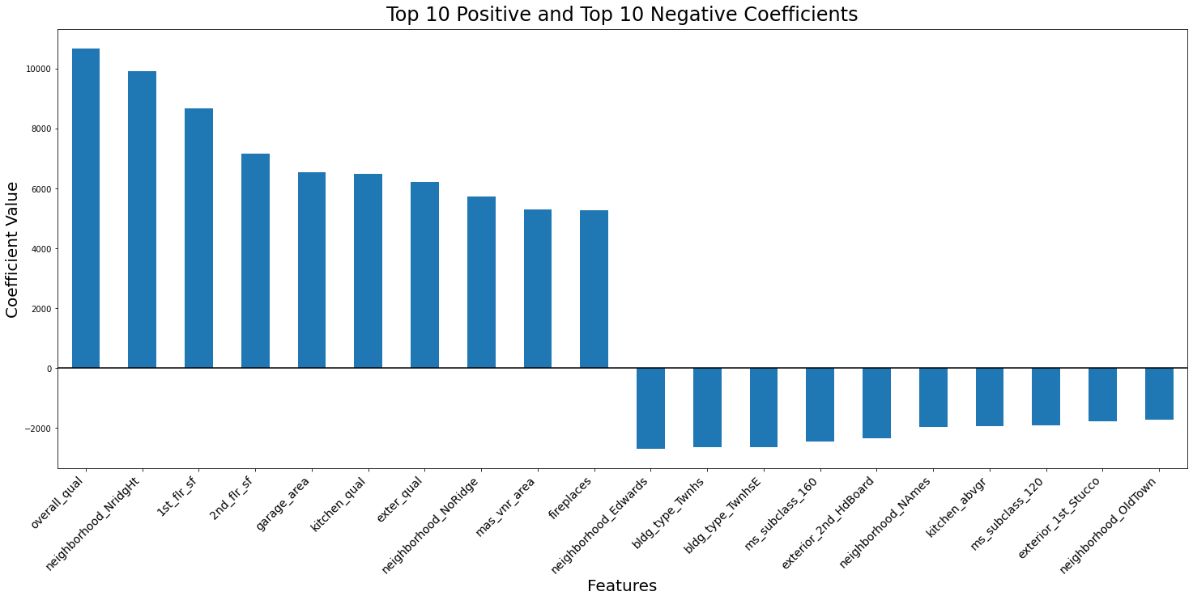
Findings and Recommendations
Using ridge model, we have obtained the top 10 factors (coefficients) which impact the housing sale price in a positive and negative manner.

Slide 9
Neighborhood
2 neighborhoods that have +ve impact: Northridge Height and Northridge.
3 neighborhoods that have -ve impact: Edwards, North Ames and Old Town.

Slide 10
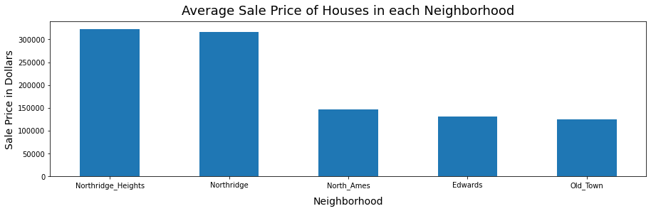
Neighborhood
Observations based on Saleprice
Houses in Northridge Heights and Northridge have mean sale price of >$300,000, yielding higher amount of revenue and commission.
Houses in North Ames, Edwards, and Old Town have mean sale price of <$150,000, yielding lesser amount of revenue and commission.
Recommendation
Realtors could focus more on marketing the houses in Northridge Heights and Northridge to generate higher revenue through higher sale prices.

Slide 11
Quality of House
The Overall, Exterior and Kitchen Qualities of the house all have a positive impact on sale prices.

Slide 12
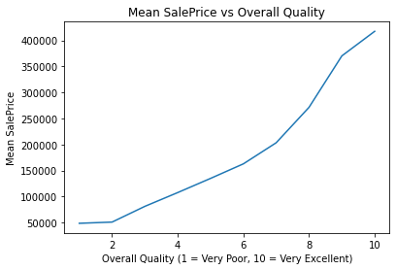
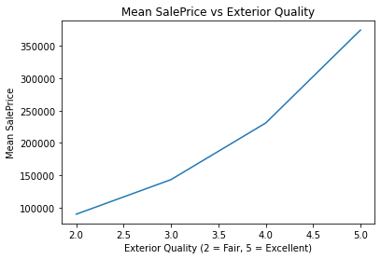
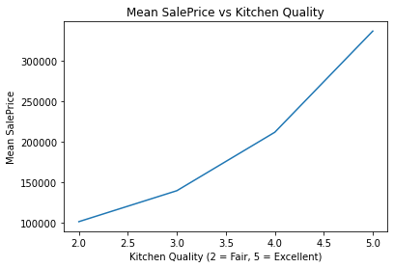
Quality of House
The higher the Overall, Exterior, and Kitchen Qualities of the house, the higher the mean sale price of the house.

Slide 13
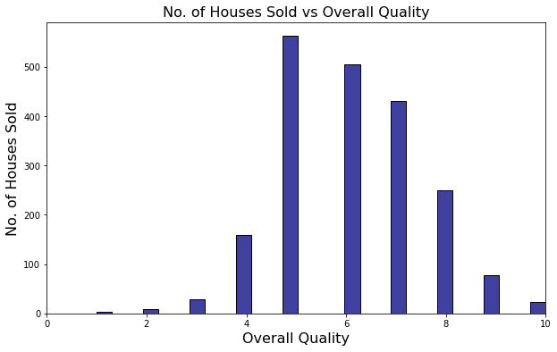
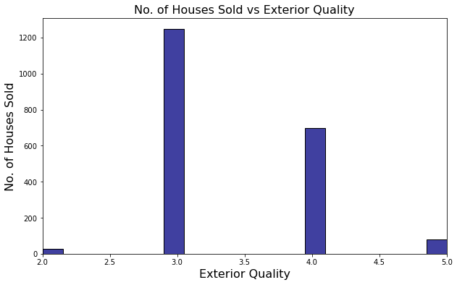
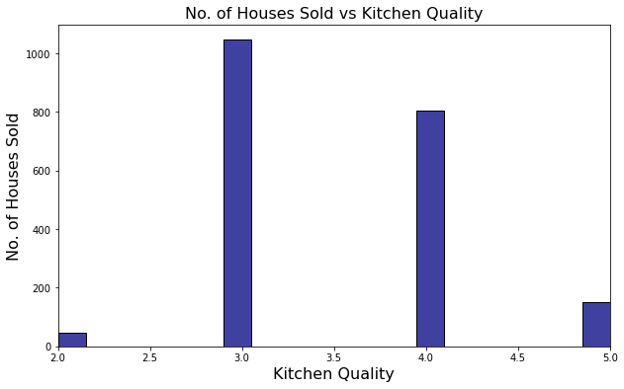
Quality of House
Current situation: Most number of houses sold -
have 3 - 4 (Average - Good Rating) for exterior quality and kitchen quality,
and a range of 5 to 8 (Average- Very Good Rating) for overall quality.
Recommendation
For clients with below average housing quality, advice them to refurbish their home.
For clients with average/good housing quality, can try persuading them to improve housing quality even more to differentiate themselves for a higher sale price.

Slide 14
No. of Fireplaces increases Sale Price
Notes:
-we see that number of fireplaces in a house is one of the top features in increasing sale price

Slide 15
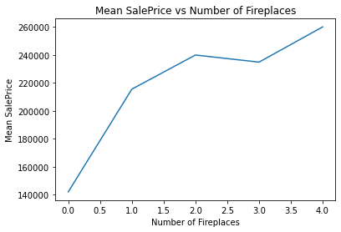
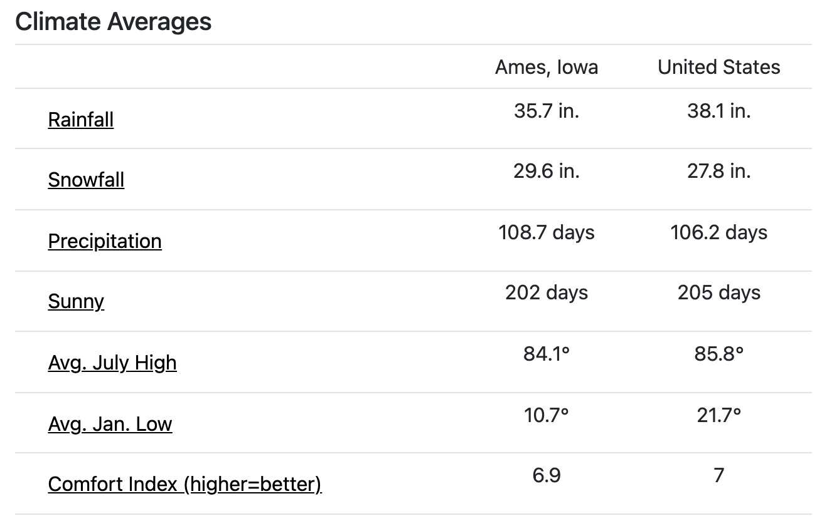
Fireplaces are important in Ames, Iowa
Largest jump in sale price from 0 to 1 fireplace
Source: Ames, Iowa Weather against US average
Notes:
-fireplaces are important in Ames, the sale price increases with the number of fireplaces found in homes
-most drastic increase seen in houses with no fireplace compared to houses with 1 fireplace
-aim to sell houses with fireplaces → Ames hase higher than average snowfall and the lower than average temperature Jan where is is usually the coldest. it is cold in Ames, so push for selling a house with fireplace
-advise clients to build a fireplace if they do not have one in order to increase the value of their house

Slide 16
Features to Avoid
Exterior 2nd HdBoard:
Poor moisture resisting properties
Requires periodic inspection and maintenance
Exterior 1st Stucco:
Wooden frame underneath
Does not do well in wet climates (eg. high snowfall)
sources: Stucco, Hardboard
Notes:
-focus on these housing exteriors → they actually lower the house sale pricing so do avoid houses with these exteriors
-Stucco exteriors have wooden frames underneath a concrete-like shell, so they do not do well in wet climates → Ames has higher than average snowfall as discussed in the previous slide so stucco is not ideal. the wooden frame may rot in these wet conditions
-hardboard has poor moisture resisting properties → again, Ames is relatively wet with the high snowfall so they are not suitable. On top of that, hardboard requires periodic inspection and maintenance so potential home owners may avoid them

Slide 17
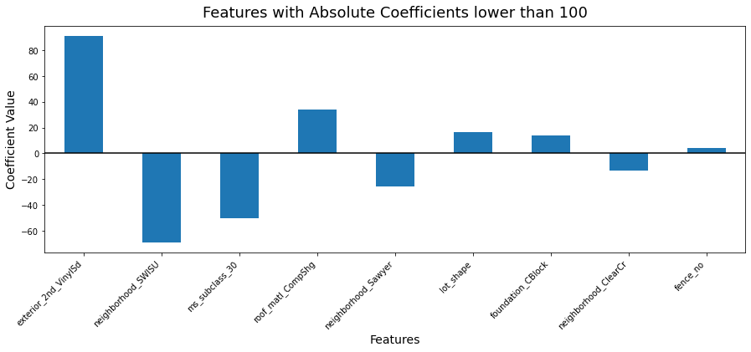
Lot Shape and Fence do not affect Sale Price
Notes:
-might think that the lot shape of a house or whether or not a house has a fence will affect the sale price → square or oval shape house feels more spacious? fence gives the house more privacy? we may feel they may sell for a higher price due to to this
-but according to our analysis, they don’t affect the sale price! → no need to show biasness for houses based on these features, they won’t generate more revenue for you

Slide 18
Revenue Generation
There are TWO WAYS realtors can increase their earnings:
Sell houses that have a higher sale price evaluation
Sell MORE houses
What are the features in a house that have led to higher number of houses being sold over the past 4 years?
Is BIGGER always BETTER?

Slide 19
Square Footage affects Sale of House
| 1st floor | 2nd floor | Garage |

Slide 20
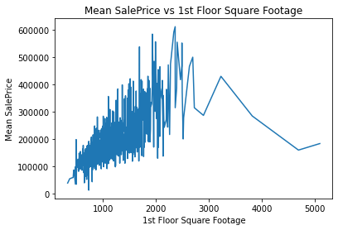
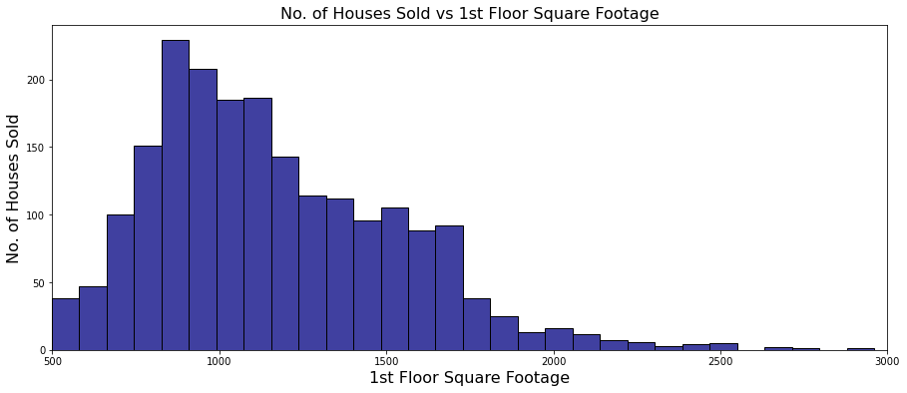
1st Floor Square Footage
A larger 1st Floor Square Footage generally fetches a higher sale price.
Houses with a 1st Floor approx 800 - 1200 sqft have been the most commonly sold, with houses 800 - 900 sqft being the standout performer.

Slide 21
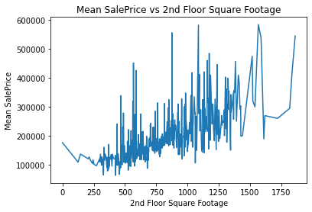
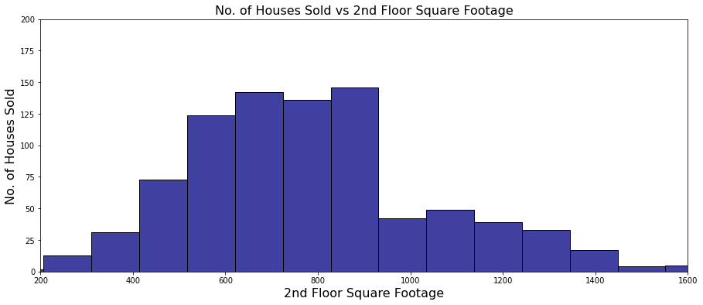
2nd Floor Square Footage
A larger 2nd Floor Square Footage generally fetches a higher sale price.
Imagine having a 1st Floor that’s 800 - 900 sqft and...
On top of that (literally), a 2nd Floor that measures 500 - 900 sqft!

Slide 22
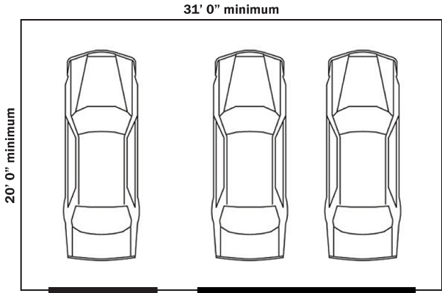
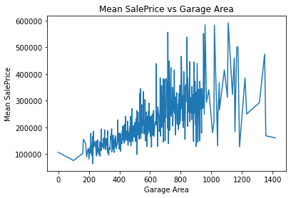
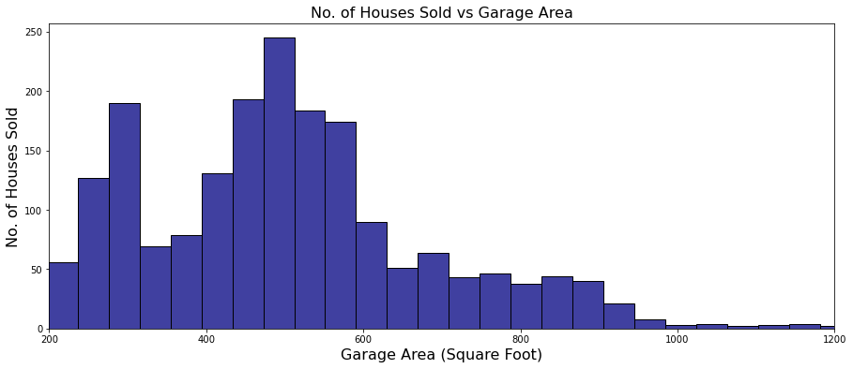
How big a Garage do you REALLY need?
240 440 620 0
A larger Garage Area generally fetches a higher sale price.
300 sqft, and a range of 450 - 600 sqft seems to be the ideal garage size for most people. But why?
The magic number is 500 sqft.

Slide 23
Why BIGGER is NOT always BETTER!
A higher square footage generally results in a higher sale price.
Higher Sale Price => Lower Affordability
Lower Affordability => Fewer Potential Buyers
Fewer Potential Buyers => Lesser No. of Houses Sold
This is in line with our earlier data where the highest sale volume did not go to houses with the highest square footages.

Slide 24
Gaps that need to be filled:
Total No. of Houses in Neighborhoods
This would allow us to evaluate the percentage % of houses that are sold across all neighborhoods.
Demographic of Neighborhood and Buyers
Age range, Marital Status, Family size, No. of kids could play a part in helping realtors recommend the right houses to the right buyers.
Sale price in real value to take into account of inflation
Rate of inflation would allow us to “reflect” the past sale prices based on today’s economy.
Notes:
If House A sold in 2007 with a fireplace at $1 million, and House B sold in 2009 without a fireplace at $1 million, does that mean having a fireplace does not have an impact on a house’s sale price? We can’t say that with certainty unless we evaluate both sale prices on a level playing field.

Slide 25
Conclusion:
Neighborhood
Focus on marketing the houses in Northridge Heights and Northridge.
Quality of House
Advice clients with below average housing quality to refurbish their home.
Fireplaces
Focus on marketing houses with at least 1 fireplace and encourage clients to build a fireplace if they do not have one.
Housing Exteriors
Avoid houses with hardboard or stucco exteriors as they are prone to rot and mold especially with the above average snowfall in Ames.
BIGGER is NOT always BETTER
A bigger house may have a higher potential sale price, but that also means that it could have a lower chance of being sold due to a lower number of potential buyers who can afford it
Notes:
If House A sold in 2007 with a fireplace at $1 million, and House B sold in 2009 without a fireplace at $1 million, does that mean having a fireplace does not have an impact on a house’s sale price? We can’t say that with certainty unless we evaluate both sale prices on a level playing field.

